Slide 1
Constraint Satisfaction Problems
Chapter 7

Slide 2
Outline
Constraint Satisfaction Problems (CSP)
Backtracking search for CSPs
Local search for CSPs

Slide 3
Constraint Satisfaction Problems (CSPs)
Standard search problem:
  state is a "black box“ – any data structure that supports successor function, heuristic function, and goal test
CSP:
  state is defined by variables X_{i} (i=1,…,n) with values from domain D_{i}
  goal test is a set of constraints C_{i} (i=1,…,m) specifying allowable combinations of values for subsets of variables
Simple example of a formal representation language
Allows useful general-purpose algorithms with more power than standard search algorithms

Slide 4

Example: Map-Coloring
Variables WA, NT, Q, NSW, V, SA, T
Domains D_{i} = {red,green,blue}
Constraints: adjacent regions must have different colors
e.g., WA ≠ NT, or (WA,NT) in {(red,green),(red,blue),(green,red), (green,blue),(blue,red),(blue,green)}

Slide 5

Example: Map-Coloring
Solutions are complete and consistent assignments, e.g., WA = red, NT = green,Q = red,NSW = green,V = red,SA = blue,T = green

Slide 6

Constraint graph
Binary CSP: each constraint relates two variables
Constraint graph: nodes are variables, arcs are constraints

Slide 7
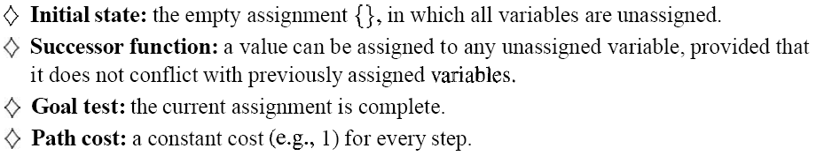
CSP = Incremental Formulation

Slide 8
Varieties of CSPs
Discrete variables
  finite domains:
    n variables, domain size d → O(d^{n}) complete assignments
    e.g., Boolean CSPs, incl.~Boolean satisfiability (NP-complete)
  infinite domains:
    integers, strings, etc.
    e.g., job scheduling, variables are start/end days for each job
    need a constraint language, e.g., StartJob₁ + 5 ≤ StartJob₃
Continuous variables
  e.g., start/end times for Hubble Space Telescope observations
  linear constraints solvable in polynomial time by linear programming

Slide 9
Varieties of constraints
Unary constraints involve a single variable,
  e.g., SA ≠ green
Binary constraints involve pairs of variables,
  e.g., SA ≠ WA
Higher-order constraints involve 3 or more variables,
  e.g., cryptarithmetic column constraints

Slide 10

Example: Cryptarithmetic
Variables: F T U W R O X₁ X₂ X₃
Domains: {0,1,2,3,4,5,6,7,8,9}
Constraints: Alldiff (F,T,U,W,R,O)
  O + O = R + 10 · X₁
  X₁ + W + W = U + 10 · X₂
  X₂ + T + T = O + 10 · X₃
  X₃ = F, T ≠ 0, F ≠ 0

Slide 11
Real-world CSPs
Assignment problems
  e.g., who teaches what class
Timetabling problems
  e.g., which class is offered when and where?
Transportation scheduling
Factory scheduling
Notice that many real-world problems involve real-valued variables

Slide 12
Standard search formulation (incremental)
States are defined by the values assigned so far
Initial state: the empty assignment { }
Successor function: assign a value to an unassigned variable that does not conflict with current assignment
  → fail if no legal assignments
Goal test: the current assignment is complete
This is the same for all CSPs
Every solution appears at depth n with n variables
→ use depth-first search
Path is irrelevant, so can also use complete-state formulation
b = (n - l )d at depth l, hence n! · d^{n} leaves

Slide 13
Backtracking search
Variable assignments are commutative}, i.e.,
[ WA = red then NT = green ] same as [ NT = green then WA = red ]
Only need to consider assignments to a single variable at each node ( b = d )
  There are n! · d^{n} leaves, d^{n} possible complete assignments
Depth-first search for CSPs with single-variable assignments is called backtracking search
Backtracking search is the basic uninformed algorithm for CSPs
Can solve n-queens for n ≈ 25

Slide 14
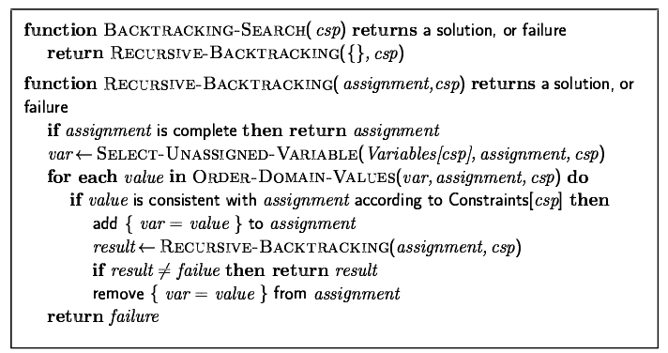
Backtracking search

Slide 15

Backtracking example

Slide 16

Backtracking example

Slide 17

Backtracking example

Slide 18

Backtracking example

Slide 19
Improving backtracking efficiency
General-purpose methods can give huge gains in speed:
  Which variable should be assigned next?
  In what order should its values be tried?
  Can we detect inevitable failure early?

Slide 20

Most constrained variable
Most constrained variable:
  choose the variable with the fewest legal values
a.k.a. minimum remaining values (MRV) heuristic

Slide 21

Most constraining variable
Tie-breaker among most constrained variables
Most constraining variable:
  choose the variable with the most constraints on remaining variables

Slide 22

Least constraining value
Given a variable, choose the least constraining value:
  The one that rules out the fewest values in the remaining variables
Combining these heuristics makes 1000 queens feasible

Slide 23

Forward checking
Idea:
  Keep track of remaining legal values for unassigned variables
  Terminate search when any variable has no legal values

Slide 24

Forward checking
Idea:
  Keep track of remaining legal values for unassigned variables
  Terminate search when any variable has no legal values

Slide 25

Forward checking
Idea:
  Keep track of remaining legal values for unassigned variables
  Terminate search when any variable has no legal values

Slide 26

Forward checking
Idea:
  Keep track of remaining legal values for unassigned variables
  Terminate search when any variable has no legal values

Slide 27
Constraint propagation
Forward checking propagates information from assigned to unassigned variables, but doesn't provide early detection for all failures:
NT and SA cannot both be blue!
Constraint propagation repeatedly enforces constraints locally

Slide 28

Arc consistency
Simplest form of propagation makes each arc consistent
X →Y is consistent iff
  for every value x of X there is some allowed y

Slide 29

Arc consistency
Simplest form of propagation makes each arc consistent
X →Y is consistent iff
  for every value x of X there is some allowed y

Slide 30

Arc consistency
Simplest form of propagation makes each arc consistent
X →Y is consistent iff
  for every value x of X there is some allowed y
If X loses a value, neighbors of X need to be rechecked

Slide 31

Arc consistency
Simplest form of propagation makes each arc consistent
X →Y is consistent iff
  for every value x of X there is some allowed y
If X loses a value, neighbors of X need to be rechecked
Arc consistency detects failure earlier than forward checking
Can be run as a preprocessor or after each assignment

Slide 32

Arc consistency algorithm AC-3
Time complexity: O(n²d³)

Slide 33
Local search for CSPs
Hill-climbing, simulated annealing typically work with "complete" states, i.e., all variables assigned
To apply to CSPs:
  allow states with unsatisfied constraints
  operators reassign variable values
Variable selection: randomly select any conflicted variable
Value selection by min-conflicts heuristic:
  choose value that violates the fewest constraints
  i.e., hill-climb with h(n) = total number of violated constraints

Slide 34
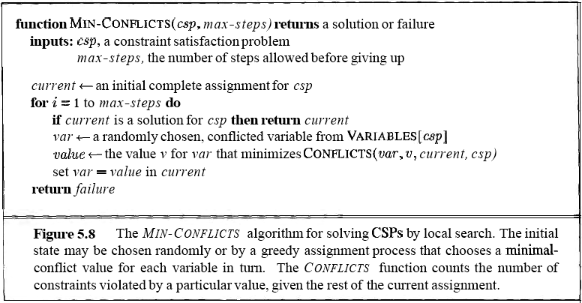
Min-conflicts

Slide 35

Example: 4-Queens
States: 4 queens in 4 columns (4⁴ = 256 states)
Actions: move queen in column
Goal test: no attacks
Evaluation: h(n) = number of attacks
Given random initial state, can solve n-queens in almost constant time for arbitrary n with high probability
(e.g., n = 10,000,000)

Slide 36
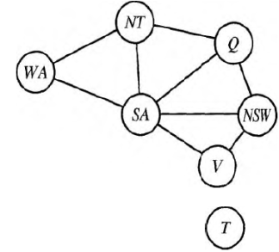
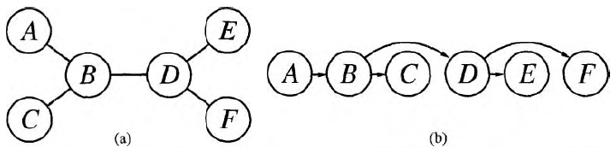
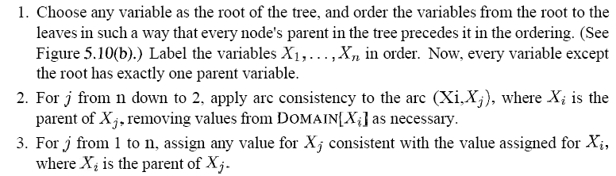
The structure of the problem
Decompose it into many subproblems(variable number c)
  O( d^{c}n/c ) vs. O( d^{n} )
Completely independent subproblems are delicious, then, but rare.
  Any tree-structured CSP can be solved in time linear in the number of variables.

Slide 37
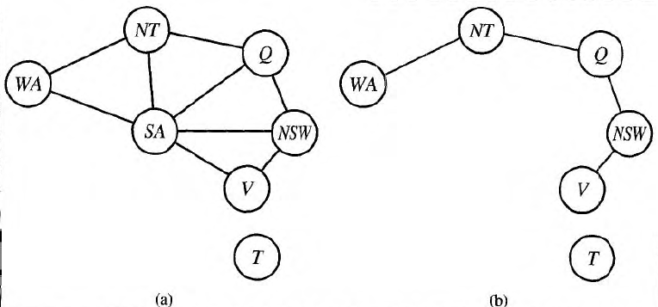
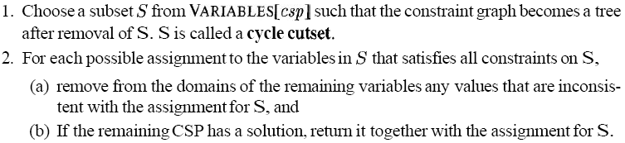

Reduced to trees
The first approach involves assigning values to some variables so that the remaining variables form a tree.

Slide 38
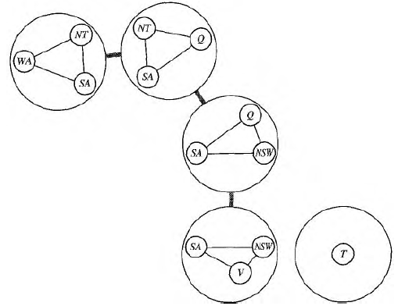
Reduced to trees
The second approach is based on constructing a tree decomposition of the constraint graph into a set of connected subproblems

Slide 39
Summary
CSPs are a special kind of problem:
  states defined by values of a fixed set of variables
  goal test defined by constraints on variable values
Backtracking = depth-first search with one variable assigned per node
Variable ordering and value selection heuristics help significantly
Forward checking prevents assignments that guarantee later failure
Constraint propagation (e.g., arc consistency) does additional work to constrain values and detect inconsistencies
Iterative min-conflicts is usually effective in practice

